Slide 1
Cloud Platform Programming
Topic Two : Introduction to cloud concepts / Intro to Interacting with the Cloud

Slide 2
Re-Cap
What are some of the key characteristics of Cloud which makes it appealing
Who provided the widely accepted Definition of Cloud Computing
What Are the 3 prominent Cloud Deployment Models
What are the 3 established Service Types

Slide 3
Overview
What is a Distributed System
What is Versioning Control - GitHub
What is The Systems Development Lifecycle ?
What About Security in the Cloud?
EC2 instances and Services (Monitoring etc)
Cloud SDK – Software Development Kit – Cloud9 and Other.

Slide 4
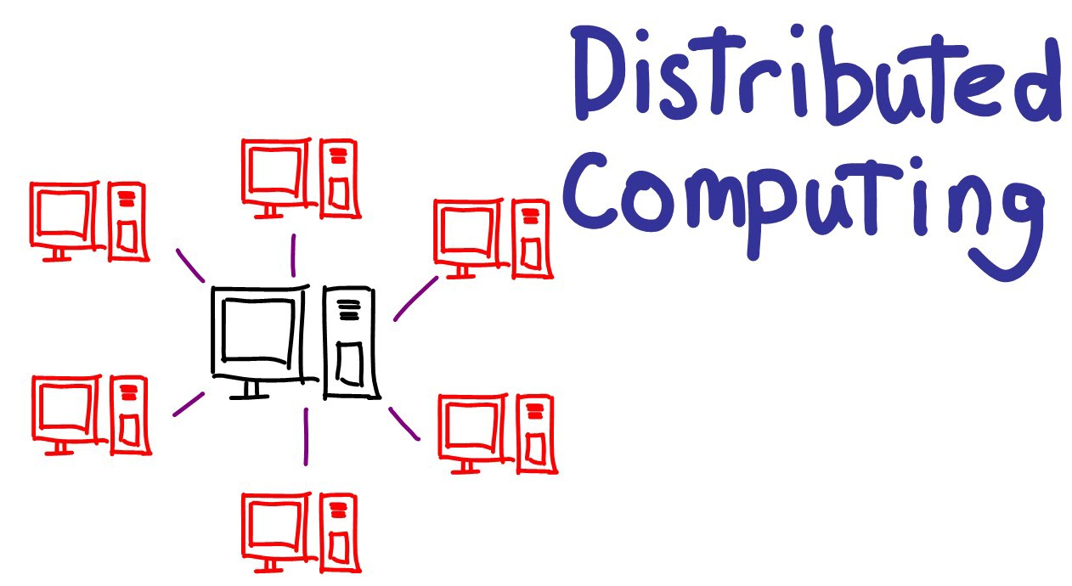
Distributed Computing
A distributed system, also known as distributed computing, is a system with multiple components located on different machines that communicate and coordinate actions in order to appear as a single coherent system to the end-user.
The machines that are a part of a distributed system may be :
computers,
physical servers,
virtual machines,
containers,
or any other node that can connect to the network, have local memory, and communicate by passing messages.

Slide 5
Distributed Computing
There are two general ways that distributed systems function:
Each machine works toward a common goal and the end-user views results as one cohesive unit.
Each machine has its own end-user and the distributed system facilitates sharing resources or communication services.

Slide 6
Benefits and challenges of distributed systems
There are three reasons that teams generally decide to implement distributed systems:
Horizontal Scalability—Since computing happens independently on each node, it is easy and generally inexpensive to add additional nodes and functionality as necessary.
Reliability—Most distributed systems are fault-tolerant as they can be made up of hundreds of nodes that work together. The system generally doesn’t experience any disruptions if a single machine fails.
Performance—Distributed systems are extremely efficient because work loads can be broken up and sent to multiple machines.

Slide 7
Types of distributed systems
Distributed systems generally fall into one of four different basic architecture models:
Client-server—Clients contact the server for data, then format it and display it to the end-user. The end-user can also make a change from the client-side and commit it back to the server to make it permanent. E,g Wikipedia
Three-tier—Information about the client is stored in a middle tier rather than on the client to simplify application deployment. This architecture model is most common for web applications.
n-tier—Generally used when an application or server needs to forward requests to additional enterprise services on the network.
Peer-to-peer—There are no additional machines used to provide services or manage resources. Responsibilities are uniformly distributed among machines in the system, known as peers, which can serve as either client or server. E.g Napster / Tor / Limewire etc

Slide 8
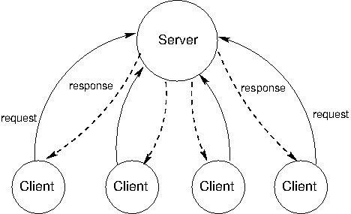
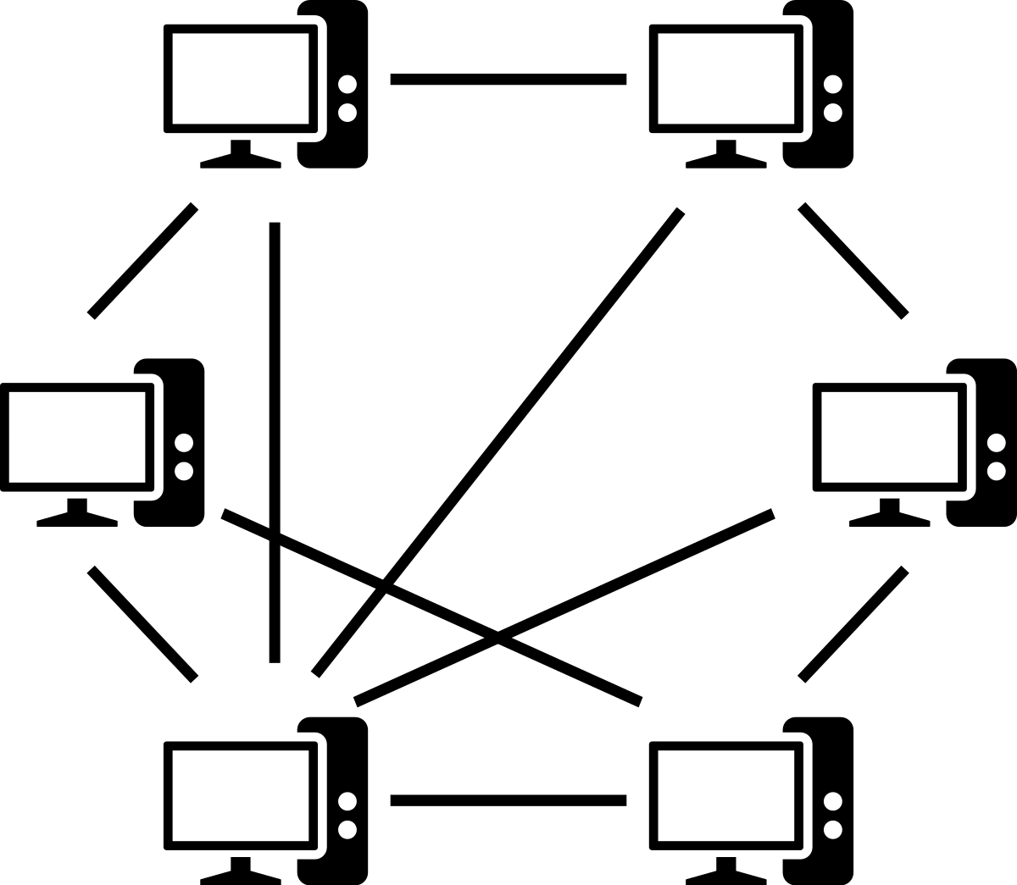
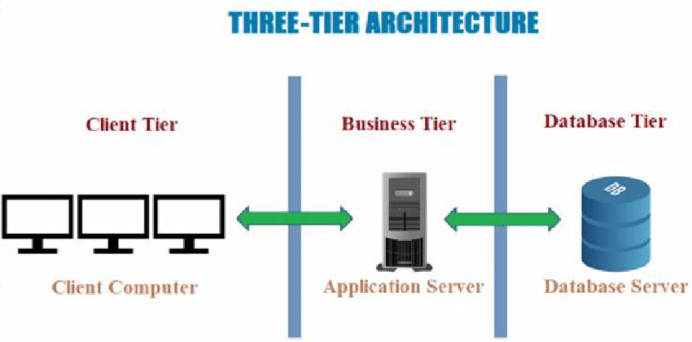
Types of distributed systems

Slide 9
Distributed Ledger Technology / Blockchain
Multiple Nodes – Geographically Separated
Updates made to Global Ledger
Updates pass through System of Checks and Balances
Once the updates have been verified
They are then Written to the ledger
Key Characteristics
Immutable
Fault Tolerant
Designed to be under attack at all times

Slide 10
Key Takeaways
Distributed systems can be made up of any machine capable of connecting to a network, having local memory, and communicating by passing messages.
By spreading out requests and workloads, distributed systems can support far more requests and compute jobs than a standard single system.
Distributed systems have endless use cases, a few being electronic banking systems, massive multiplayer online games, and sensor networks.

Slide 11
Cloud Services
Primarily we consider cloud as a provider of resources
Compute – EC2
Storage – S3
Databases – SQL noSql
Network – VPN / Secure Tunnel / VPC

Slide 12
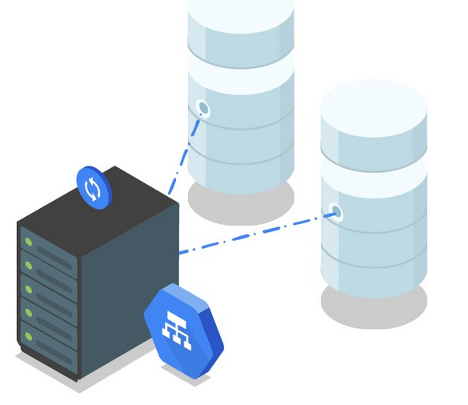
Cloud Services
We also have a considerable amount of additional services which provide
Redundancy
Disaster Recovery
Business Continuity
Improved Performance and Efficiencies
Scaling and Balancing

Slide 13
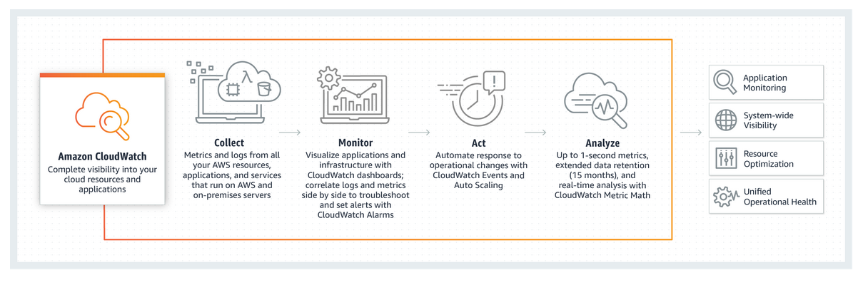
Cloud Services – Monitoring the Cloud
https://console.aws.amazon.com/cloudwatch/home?region=us-east-1
https://aws.amazon.com/cloudwatch/
Monitoring in the Cloud (Orchestrating Infrastructures on the Cloud)
Notes:
You will need to be already logged into your AWS account for the above URL to function

Slide 14
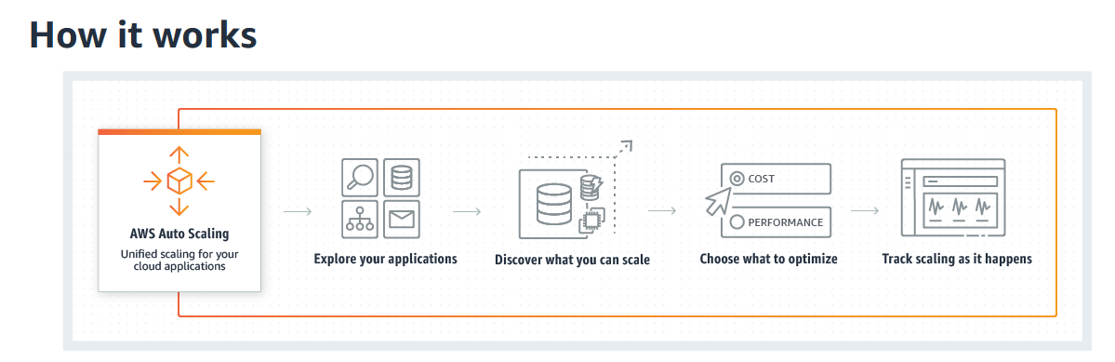
Cloud Services – Scaling / Elasticity
Auto Scaling (Expanding and Contracting Based on App needs)
https://aws.amazon.com/autoscaling/

Slide 15
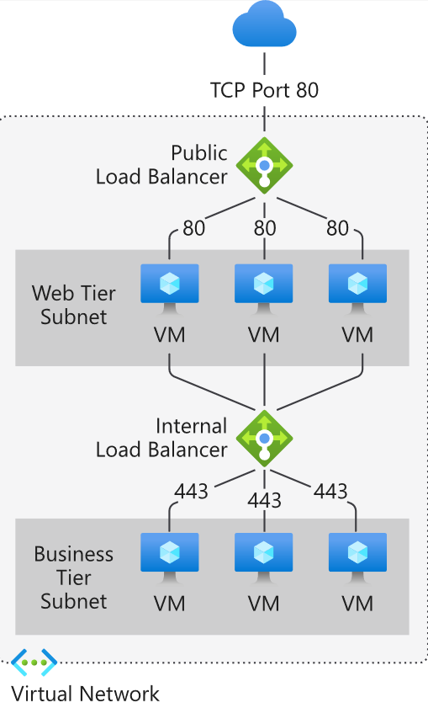
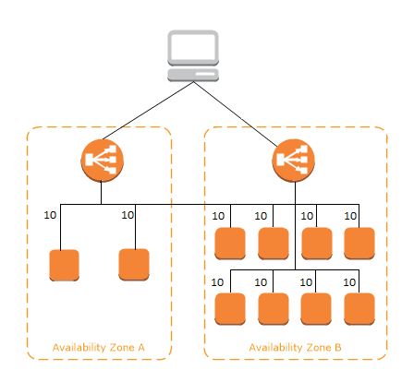
Cloud Services - ELB
Elastic Load Balancing (Re-Directing Traffic to WebApps etc)
https://docs.aws.amazon.com/elasticloadbalancing/latest/userguide/how-elastic-load-balancing-works.html
https://cloud.google.com/load-balancing
https://docs.microsoft.com/en-us/azure/load-balancer/load-balancer-overview

Slide 16

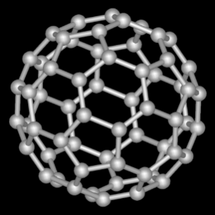
A Closer Look at Elasticity
The importance of stable repeated patterns
Aggregation of resources
Benefits at scale
Minimising inefficiencies
Energy Efficiency
The sum is greater than the parts
Elasticity entails ongoing infrastructure reconfiguration
Network
Storage
Servers and Virtual Machines
How does this impact on security?

Slide 17

A Closer Look at Elasticity
Security Implications
Orchestration of security controls in dynamically changing environment
IP addresses / VMs
created / destroyed / recreated elsewhere in infrastructure
Audit
Balance between cloud computing scale benefits and security
Managing Security
Sophisticated management infrastructure required
Configuration Management Databases (CMDBs)

Slide 18
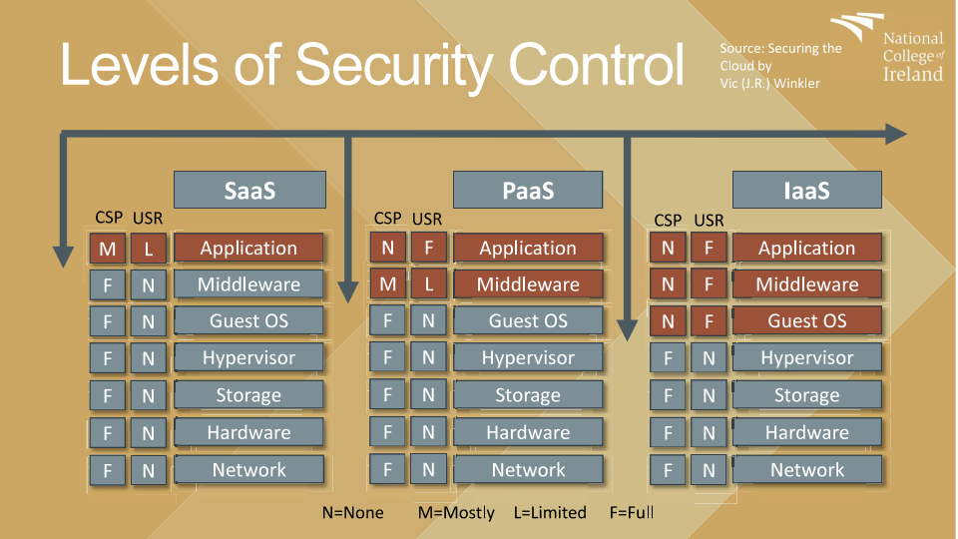
Is the Cloud Secure ?

Slide 19
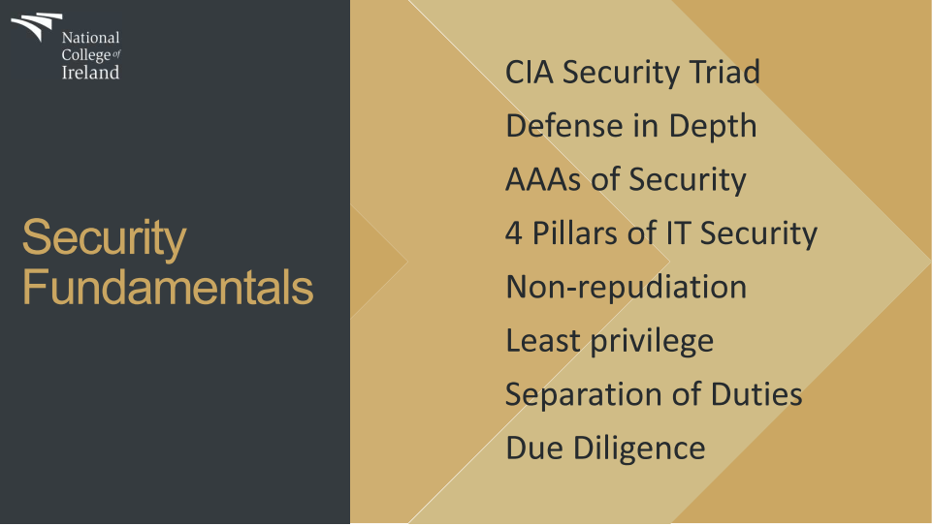
Is the Cloud Secure ?

Slide 20
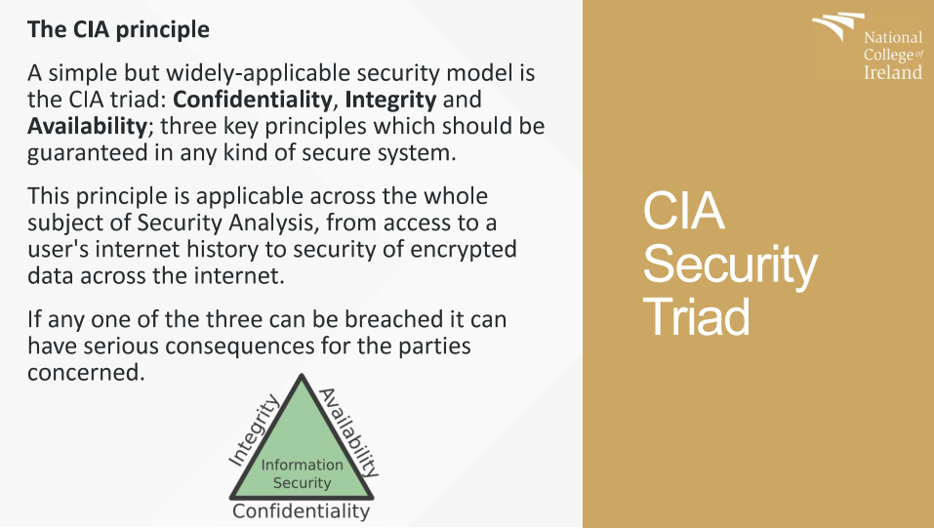
Is the Cloud Secure ?

Slide 21
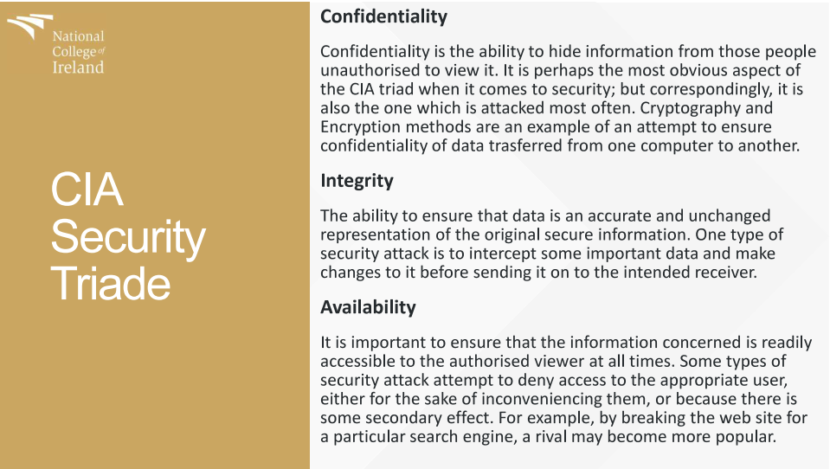
Is the Cloud Secure ?

Slide 22
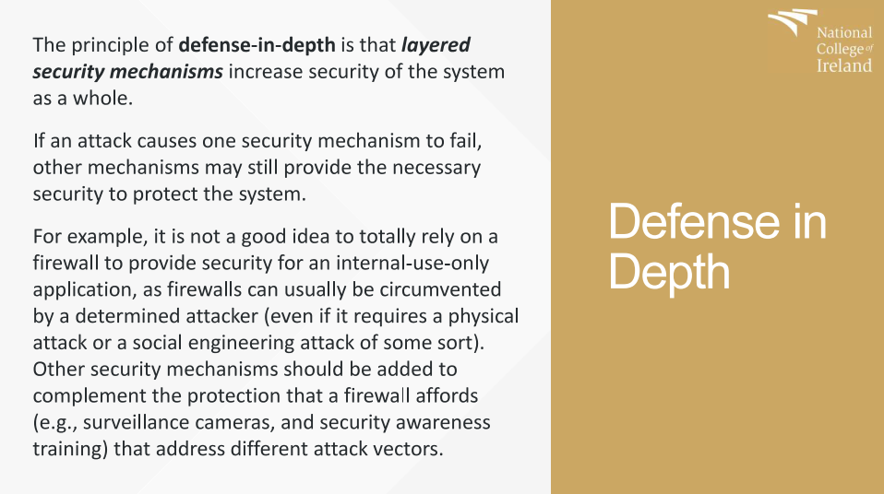
Is the Cloud Secure ?

Slide 23
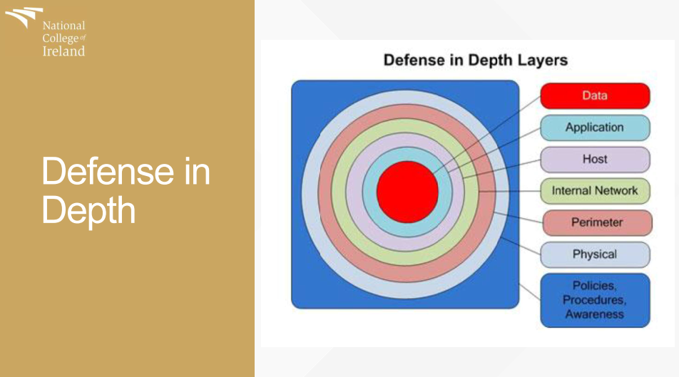
Is the Cloud Secure ?

Slide 24
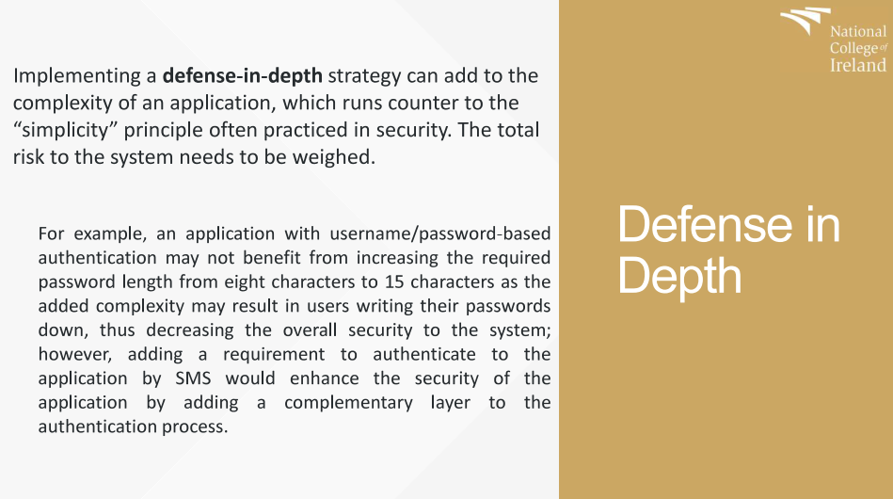
Is the Cloud Secure ?

Slide 25
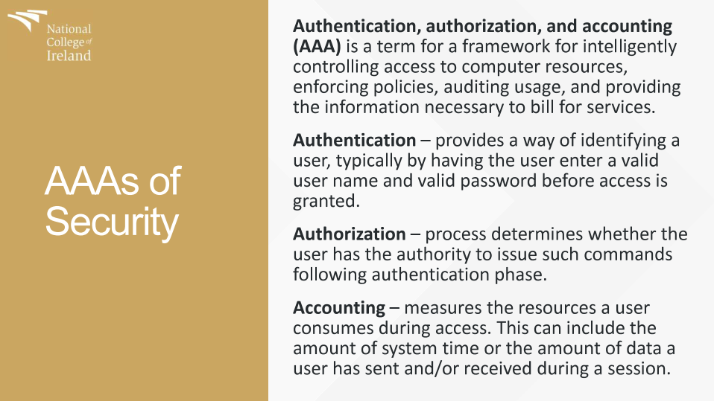
Is the Cloud Secure ?

Slide 26
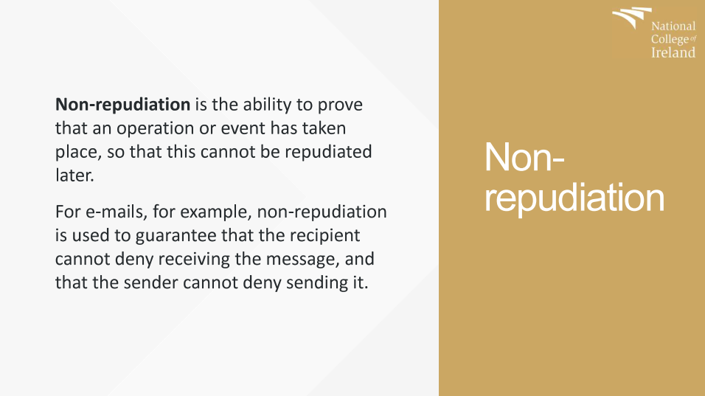
Is the Cloud Secure ?

Slide 27
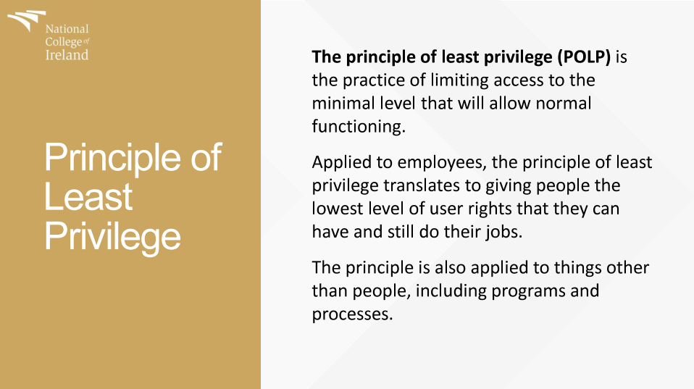
Is the Cloud Secure ?

Slide 28
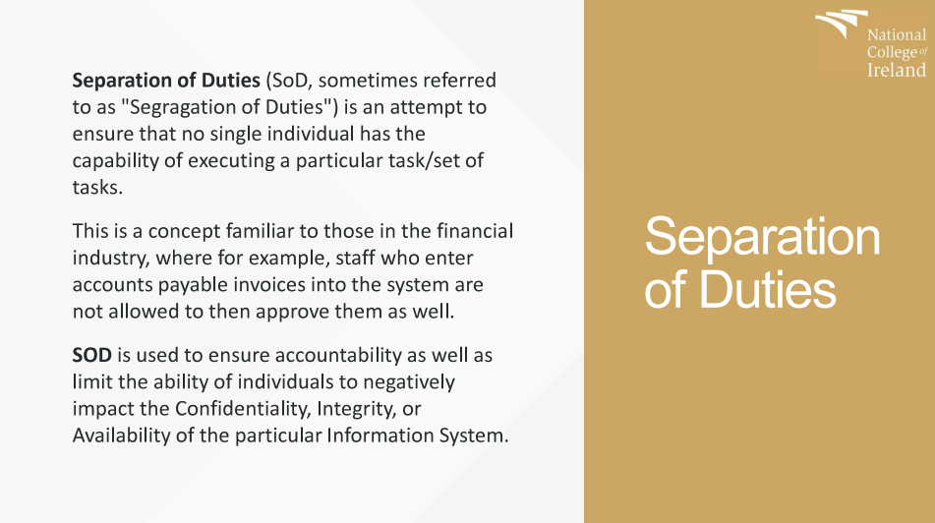
Is the Cloud Secure ?

Slide 29

Key Security Concepts
Information Security
Security of IT systems as well as the non-IT processes supporting usage of IT systems.
Computer Security
Network Security
Data Security
Information Assurance
CIA – Confidentiality / Integrity / Availability
Least Privilege Principle
Users and processes should operate with a minimal set of privileges.

Slide 30
Key Security Concepts
Authentication
Establish identity
Typically, by presenting required credentials
Authorisation
Privileges granted to users or processes
Access Control Lists (ACLs)
Cryptography
Encryption
Decryption
Cryptoanalysis
I am who I say I am…
What can I do?
DMPVE DPNQVUJOH

Slide 31

Key Security Concepts
Auditing
Generation, collection and review of system events
Network
Application
System
Review of processes and security controls
Accountability
Who?
What?
When?
How?

Slide 32
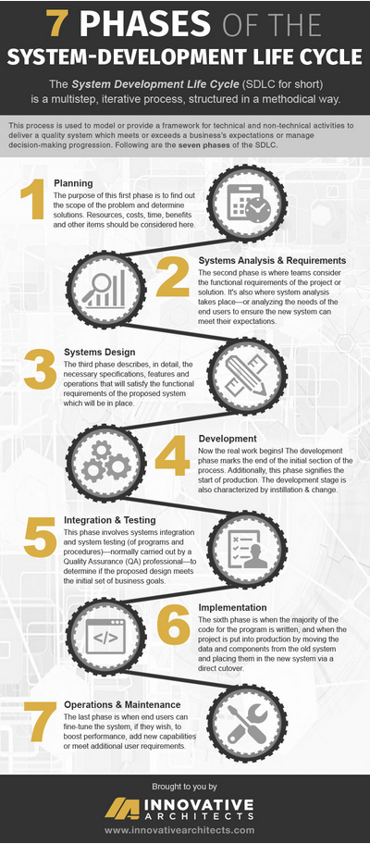
The Software Development Lifecycle SDLC
Planning
Systems Analysis & Requirements
Systems Design
Development
Integration & Testing
Implementation
Operations & Maintenance
Notes:
https://www.innovativearchitects.com/KnowledgeCenter/basic-IT-systems/system-development-life-cycle.aspx

Slide 33
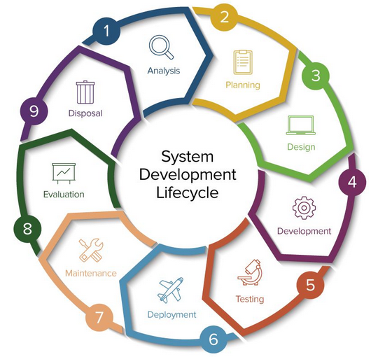
The Software Development Lifecycle SDLC
Analysis/Feasibility: For an SDLC strategy to work there should be a strong idea of what deficiencies exist in the current structure and the goals for the new approach. A feasibility study determines if you can or should accomplish the goals of the plan. Information is gathered and analyzed to identify what technical assets, personnel, and training is already in place and utilized. The study also inventories what is needed to augment or replace, and at what cost.
During this phase you determine the overall project scope, including economic, operational and human factors, identify key personnel, and develop timelines.

Slide 34
The Software Development Lifecycle SDLC
If a business determines a change is needed during any phase of the SDLC, the company might have to proceed through all the above life cycle phases again. The life cycle approach of any project is a time-consuming process. Even though some steps are more difficult than others, none are to be overlooked. An oversight could prevent the entire system from functioning as planned.
https://imgur.com/gallery/9V4n4A3

Slide 35
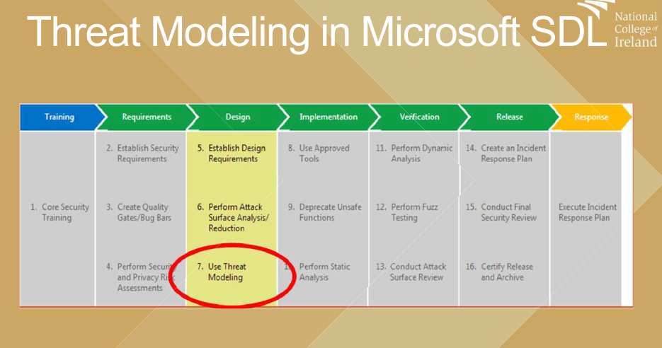
Secure Software Development Lifecycle SSDLC

Slide 36
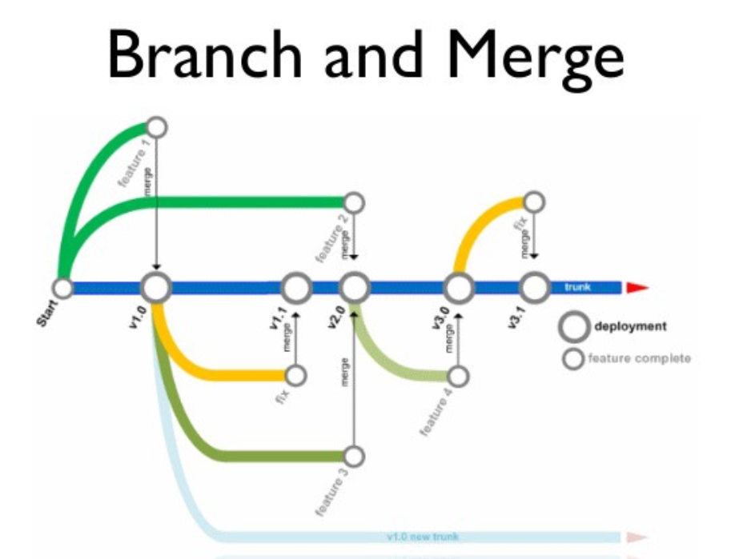
Versioning Control
What is it ?
Why is it considered Invaluable?
Services Available
The importance of version control systems for tracking changes cannot be overstated, and companies should choose the one that best suits their needs.

Slide 37
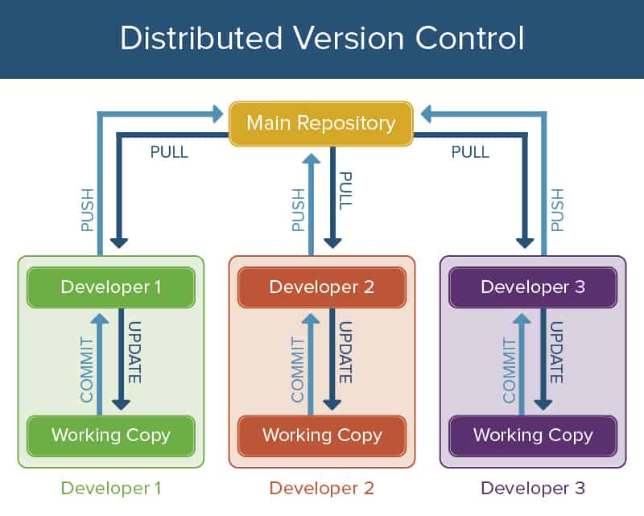
Versioning Control
The importance of version control systems for tracking changes cannot be overstated, and companies should choose the one that best suits their needs.
Notes:
https://www.smartsheet.com/software-version-control

Slide 38
Versioning Control
If you are planning to work on a big software development project that consists of technical concepts, require a collaboration of different team members and need frequent changes, then you need to use a version control system.
A version control system allows users to keep track of the changes in software development projects, and enable them to collaborate on those projects.
Using it, the developers can work together on code and separate their tasks through branches.

Slide 39
Versioning Control
The main advantages of using a version control system include streamlining the development process, management of code for multiple projects and keeping a history of all changes within a code
A version control software saves all the changes in a repository. Hence, if the developers make a mistake, they can undo it. At the same time, they can compare the new code with a previous version(s) to resolve their grievance. This can reduce human errors and unintended consequences to a great extent. A great fit for any web development company around the globe.
Additionally, it can be integrated with several software development tools like PaaS providers, integrated development environments (IDE) and build automation tools.

Slide 40
Versioning Control
There are plenty Available on the Market
Services Available
GitHub
GitLab
Beanstalk
Perforce
Apache Subversion
AWS CodeCommit
BitBucket

Slide 41
Questions & Break

Slide 42
Lab Session
Creating an EC2 instance and connecting to it.
Reviewing Cloud Watch , Monitoring and Alerts
Create an EC2 instance and Connect through SSH
Perform Key Conversion - .pem to .ppk
Login to instance
Review Cloud watch Alerts and Alarms

Slide 43
Lab Session 2
Creating a Cloud 9 IDE instance
Connecting to it
Connecting to GitHub
Performing a Push
Create A Cloud9 Environment – AMI
Create a GitHub Account
Connect Your GitHub Account to AWS
Create Files in C9
Push to GitHub

Slide 44
Lab Session 2
https://docs.aws.amazon.com/cloud9/latest/user-guide/create-environment.html
https://docs.aws.amazon.com/cloud9/latest/user-guide/sample-github.html#sample-github-install-git
https://docs.github.com/en/free-pro-team@latest/github/getting-started-with-github/create-a-repo
https://docs.github.com/en/free-pro-team@latest/github/creating-cloning-and-archiving-repositories/cloning-a-repository#platform-linux

